Slide 1
Microsoft Azure Workshop - Understanding cost modelling and sizing cloud solutions
Chris Marchal
Chris.Marchal@microsoft.com
Technical Evangelist
David Gristwood
David.Gristwood@microsoft.com
Technical Evangelist

Slide 2
Introduction and Housekeeping Welcome to Microsoft UK, 2 Kingdom Street
Fire Alarms
Emergency Exits
Toilets
Lunch and Dietary Requirements
Notes:
Any of them will run on Virtual Machines, Azure is simply a deployment switch.

Slide 3
Today’s Agenda
Introduction
What to do (Cloud Design Patterns and good practices) and what to avoid (Classic errors and mistakes)
With coffee break
Lunch
Group discussion

Slide 4
Today’s Brief
How you can control your Azure Cloud based services cost profile, whilst allowing your software and data to scale as and when you need it.
How do we predict workloads and frequency?
How do we allow for sudden demand without committing unnecessary costs?

Slide 5
The short answer….
How you can control your Azure Cloud based services cost profile, whilst allowing your software and data to scale as and when you need it. – Pricing Models and Tips
How do we predict workloads and frequency? Telemetry and Load Testing
How do we allow for sudden demand without committing unnecessary costs? – Queuing, Autoscaling and load balancing

Slide 6
The Other Questions
How do ISV’s build cloud solutions on the Azure platform for a predictable and commercially reasonable cost?
Or: How much will it cost ?
And: How much will we make (in margin)?
And: How much will we need to build / invest?

Slide 7
Scale Units Scale out, not up David Gristwood
Notes:
Any of them will run on Virtual Machines, Azure is simply a deployment switch.

Slide 8
Once Upon A Time…
… sizing for a system was (relatively) easy
Fixed on premise hardware
Static workforce
Multi-year costing
Size for maximum load
then the Internet came along and changed all of that….

Slide 9
Public cloud allows…
amazing economies of scale
ability to scale
pay for what you use
But comes at a price, in terms of (possible) re-architecting and re-thinking how to run these system, to save (potentially) lots of money

Slide 10

Red pill, blue pill
Two main approaches:
Platform as a Service
- You break down your application into sets of services, then hand over the running of these services to the platform, and let it scale and manage them
Infrastructure as a Service
- Your application runs in (virtual) machines and you are responsible for scaling and provisioning those machines

Slide 11
Managing Machine
Complex set of trade-offs, including:
What size server(s) should you use?
How should you auto-scale rules
What upper limits do you need to handle?
How do you maximise the density of the servers

Slide 12
VM sizes
General Purpose
Balanced CPU/memory: dev & test workloads, low / med traffic sites, small / med db
A0-4 Basic, Av2 Std D1-5v2, D1-4v1, A0-7std
Compute Optimised
High CPU/memory ratio : medium web, network, app servers
F Series (SSD)
Memory optimised
High memory/core ratio: sql, cache, in-memory analytics
D11-15, G series
Storage optimised
High disk throughput: big data, sql, no-sql
L Series
GPU
Compute & graphics-intensive workloads
N Series
High Performance Compute
Fastest most powerful CPUs, RDMA
H Series, A8 - 11

Slide 13
“Scale Units”
Group of the specific resources needed to support a fixed number of users
Could be single machine, could include databases, networks, storage, etc
All resources have limits – IOPs, maximum size, latency, throughput, etc
It is a predictable, tested unit, of deployment
Side by side, or across multiple data centers
Also provides resilience
Assumes
linear growth, “standard” user, acceptable latency, etc
Most system designers don’t test and plan to this level

Slide 14

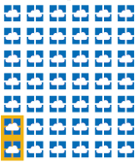
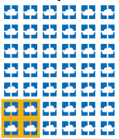
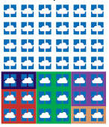
Scaling out Scale Units
Small scale units give best granularity, but come at trade-off of managing deployment and scaling
When to deploy a new scale unit
How to maximise density of units deployed

Slide 15
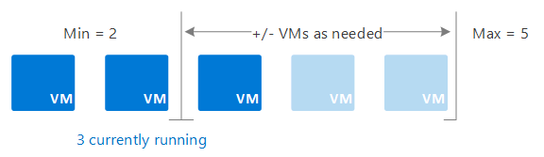
Azure Services to help you scale
App Services
Service Fabric
Azure Container Services
Azure Batch
VM Scale sets
Common theme is scale management:
Microsoft Azure Autoscale
Metric-based - For example, do this action when CPU usage is above 50%.
Time-based - For example, trigger a webhook every 8am on Saturday in a given time zone

Slide 16
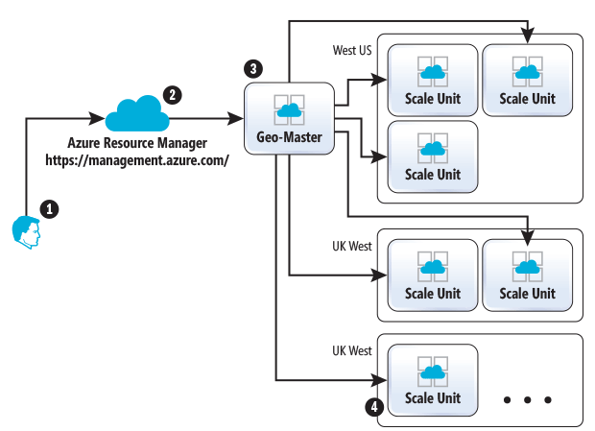
Azure App Service Architecture
The Geo-Master has context about all scale units worldwide
It finds the most suitable scale unit and forwards request to the appropriate scale unit
https://msdn.microsoft.com/en-us/magazine/mt793270.aspx

Slide 17
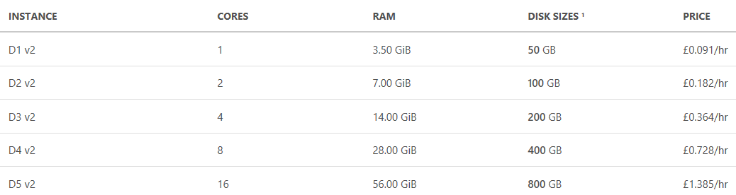

Scale Units using Virtual Machines
D1-5 v2 instances are the latest generation of General Purpose Instances
Based on the 2.4 GHz Intel Xeon® E5-2673 v3 (Haswell) processor
Offer a powerful combination of CPU, memory and local disk for most production applications
Imagine a single D1v2 VM instance of your app supports 500 users, which we will bill @~£90 per month
So, that is
1x D1v2 instance supports 500 users @~£90
1x D2v2 instance supports 1,000 users @~£180
1x D3v2 instance supports 2,000 users @~£360
1x D4v2 instance supports 4,000 users @~£720
1x D5v2 instance supports 8,000 users @~£1440
So, what the best system for 3,000 users?
3x D2v1 supports 3000 users = ~£540 (100% capacity)?
2x D3v2 supports 4000 users =~£720 (75% capacity)?
Important note – each size doubles, so its an exponential growth. i.e. we don’t have a 12 core machine
Notes:
At the opposite end of the scale we have the scenario where one server, or service deployment is not large enough for your entire service.
In this scenario we can break the service apart into multiple ‘units of scale’, or ‘stamps’, this reduces the size of the hosted service and can allow you to ‘home’ a tenant, or part of a tenant (in a multi-tenant scenario) onto it’s own instance of a service.
Minimise ‘global’ services as they are difficult to predict and scale.

Slide 18
Scale Units and Deployment Stamps
Single Server (Scale Up)
Stamps / Scale Units + Autoscaling out
Q: A 10 user system costs how much to run in this model ?
Q: A 1000 user tenant costs how much to run ?
Q: A 35,000 user tenant costs how much to run ?
Q: A 10 user system costs how much to run in this model ? ~£90 (Single instance, use the compute resource consolidation pattern to group tenants together onto hardware here, 1 single VM stamp should support 50x10 user tenants).
Q: A 1000 user tenant costs how much to run ? ~£180 (2x VM instance)
Q: A 35,000 user tenant costs how much to run ? 72 x D1v2 VM or 1x D8V2 VM ? How much are they ?
Q: A 10 user system costs how much to run in this model ? ~£90 (Single instance, use the compute resource consolidation pattern to group tenants together onto hardware here, 1 single VM stamp should support 50x10 user tenants).
Q: A 1000 user tenant costs how much to run ? ~£180 (2x VM instance)
Q: A 35,000 user tenant costs how much to run ? 72 x D1v2 VM or 3x G5 VM ? How much are they ?
Notes:
At the opposite end of the scale we have the scenario where one server, or service deployment is not large enough for your entire service.
In this scenario we can break the service apart into multiple ‘units of scale’, or ‘stamps’, this reduces the size of the hosted service and can allow you to ‘home’ a tenant, or part of a tenant (in a multi-tenant scenario) onto it’s own instance of a service.
Minimise ‘global’ services as they are difficult to predict and scale.
These scale units, want to be as small as you can make them, and you want to be able to increase capacity by adding more of them
Consider load-balancers and geo-distribution of services
Stateless services scale automatically across nodes, stateful services need some intervention.
(Common Caches, and sticky sessions, synchronous data replication)

Slide 19
Using the pricing calculator
Q: A 10 user system costs how much to run in this model ? ~£90 (Single instance, use the compute resource consolidation pattern to group tenants together onto hardware here, 1 single VM stamp should support 50x10 user tenants).
Q: A 1000 user tenant costs how much to run ? ~£180 (2x VM instance)
Q: A 35,000 user tenant costs how much to run ? 72 x D1v2 VM or 2x G5 VM ? How much are they ?
Compute only pricing (not network or storage, but those costs are trivial).
10 User tenant = 1 x D1v2 = £90.39/month / 50 = £1.80 per 10 user tenant
1000 User tenant = 2 x D1v2 = £180.77 / month = £180 per 1000 user tenant
35,000 User tenant = Either :-
72 x D1v2 = £6,507 / month / 1 = £6,507 per 1000 user tenant
3 x G5 = £18,465 / month = £18,465 per 35,000 user tenant
So you can save 2/3 on your compute costs by taking this approach,
if your app will chunk down
Notes:
Lets Open :- https://azure.microsoft.com/en-us/pricing/calculator/
Add Virtual Machines
Select UK South / Windows / Standard / D1V2 : £90.39/month
Change the number to 2x D1V2 : £180.77/month
Change the number to 72 x D1V2 : £6507.73/month
Change the number to 3 x size to G5 (Switch to West Europe) : £18465/month

Slide 20
Microservices What about Azure Service Fabric and containers?
Notes:
Let’s look at some patterns and practices that can be used to mitigate the cost of building high-performance solutions.
How can you ensure maximum performance and scalability for a commercially reasonable Cost of Service?

Slide 21
What Is Service Fabric?
Clustering – Create a pool of resources
Hosting & Environment Abstraction – Run your workloads
High Availability – Detect and React to Failures
Orchestration – Manage desired state configuration
Management – Upgrades and Health monitoring
Programming Model – Microservices Application Platform
Reliability & Latency – Support for Stateful workloads
Integrated Solution – Necessary tools already integrated
Battle Hardened – Technology has been in use for ~10yrs
Notes:
DS platform from MS makes it easy to Dev/Depl/Op scalable ms
Internal -> Public
Relatively large list
Broad list – Every facet matters at scale (300k)
Battle hardened
Lets try to understand the rationale for moving in this direction

Slide 22
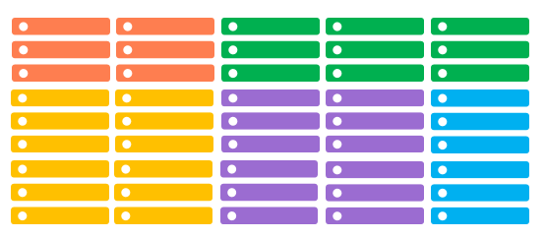
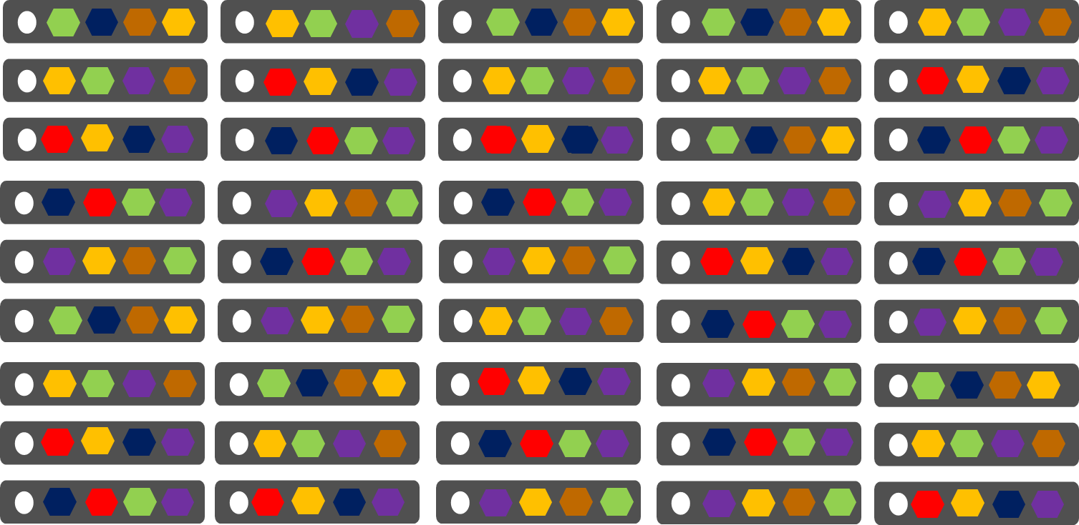
VMs vs Service Fabric – VM Density
VMs
Azure Service Fabric
1 service instance per VM
Slower deployment & upgrades
Slower scaling of roles up/down
Many microservices per VM
Fast deployment & upgrades
Fast scaling in/out of microservices
Notes:
SF is logical progression from CS
CS: Bound by VM creation/update time. *Dev
SF: Faster, no coupling, Dev+
Not quite apples to apples.

Slide 23



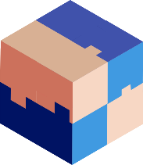



Stop anywhere when migrating to microservices
Traditional app
Hosted as guest executable or container in Service Fabric
With new microservices added alongisde
Breaking into microservices
Transformed into microservices
Notes:
Workload flexibility is important not just for supporting existing archs but for supporting the migration.

Slide 24
Data Tier Scaling What about the data tier, isn’t that the hardest tier to scale?

Slide 25
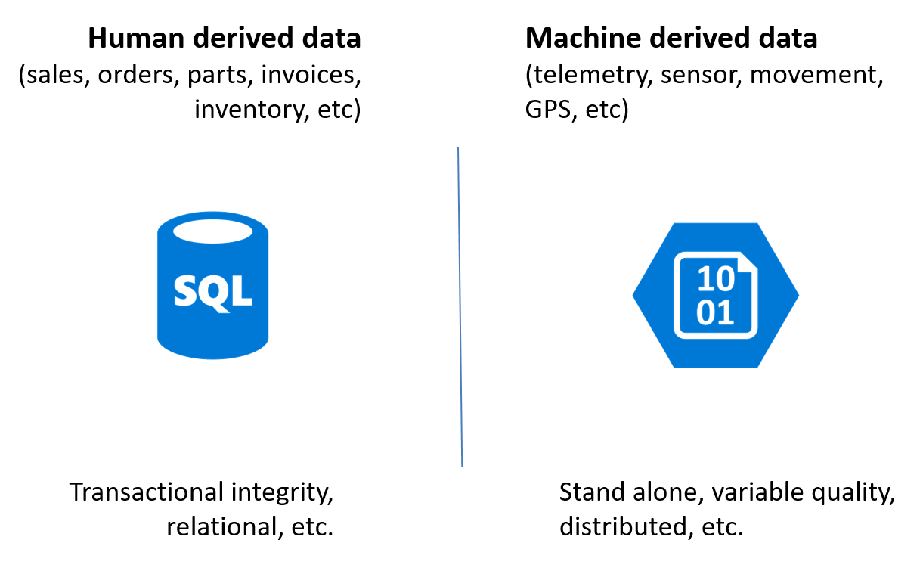
Choose the right type of storage
VMs
Azure
storage
Relational
NoSQL
Big Data
Cache
Search
CosmosDB
DB

Slide 26
Use an appropriate type of Store
Storage Mechanism | Interaction | Starts at (Avg)* | Min GB | Max TB | Use Case
Azure ‘Cool’ Block Blob storage | REST (Blob), SDKs | £0.01/GB | 0 | 500 | Archive, nearline unstructured https storage
Azure ‘Hot’ Block Blob storage | REST (Blob), SDKs | £0.02/GB | 0 | 500 | Online unstructured https storage
Azure Virtual Machine Disk / Page Blob Storage | VM Only | £0.05/GB | 0 | 500 (Not per VM) | High Performance storage, up to 500 IOPS per disk volume (up to max volumes per VM type).
Azure Table Storage | REST (Blob), SDKs | £0.07/GB | 0 | 500 | Tabular, non-relational (NoSQL) Mass-scale dictionary https lookup service, partitioned by default, no secondary indexes allowed.
Azure Premium Virtual Machine Disk/ Page Blob Storage | VM Only | £0.13/GB | 128 | 35 | GUARANTEED High Performance storage, up to 5000 IOPS per disk volume (up to max volumes per VM type > 80,000 IOPS & 2TB / Second).
Azure SQL Database Basic | T-SQL (TDS) | £2.33/GB * | 2 | 1 | Tabular, Scalable, Classic Relational DBMS, Always On
Azure SQL Data Warehouse | T-SQL (TDS) | £1.03/GB * | 1024 | ~250 Compressed (~1PB) | Scalable, Tabular, Parallelized, Relational DBMS, can be paused.
Azure Cosmos DB | REST (Blob), SDKs | £4.62/GB * | 1 | 0.01 (10GB) | JSON Indexed document storage, can be partitioned.
Azure Data Lake Store | WebHDFS | £0.06/GB * | 1024 | 1PB per file (!) | Hadoop based unstructured data storage layer. – Preview price includes 50% discount off US pricing, not available in Europe yet.
* These are indicative numbers, these numbers are variable on a number of factors. For example SQL DW starts billing at 1TB of capacity, storage has an access charge per million transactions.
Notes:
Admin / IT Pro consideration
Switch in portal. Explain each type of storage and where it is appropriate
Talk about Optimistic concurrency for blobs and containers
The Storage service assigns an identifier to every object stored. This identifier is updated every time an update operation is performed on an object. The identifier is returned to the client as part of an HTTP GET response using the ETag (entity tag) header that is defined within the HTTP protocol.
Clarify that the Performance and latency levels locally for LRS / ZRS / GRS and RA-GRS are *identical* the secondaries are written to ASYNCHRONOUSLY.

Slide 27
Scaling out the data tier: Guidance
Consider Archiving and Tiered blob storage patterns
Hot and cool blob storage
Azure SQL Data Warehouse is billed by runtime compute + storage, and can be paused.
Azure SQL Database Elastic Pools and sharding can be used to leverage the Compute Resource Consolidation pattern in a BILLING context (see next slide)

Slide 28
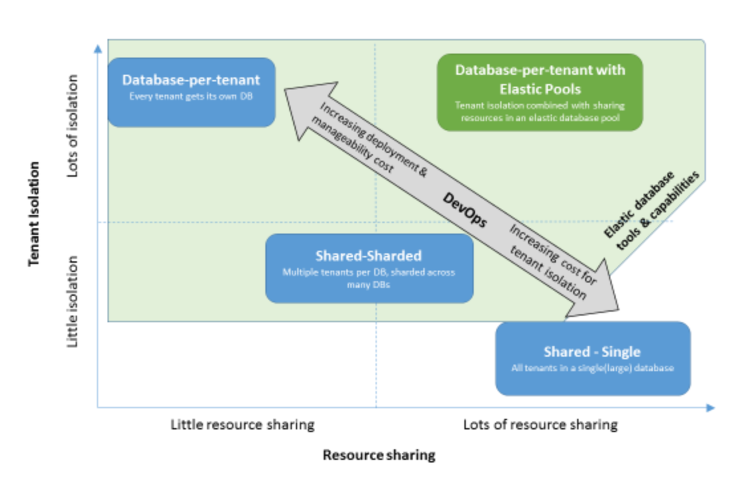
Design patterns for multi-tenant SaaS applications and Azure SQL Database
docs.microsoft.com/en-us/azure/sql-database/sql-database-design-patterns-multi-tenancy-saas-applications

Slide 29
Mind the gap Migrating to the cloud, or transitioning to SaaS charging models? David Gristwood
Notes:
Let’s look at some patterns and practices that can be used to mitigate the cost of building high-performance solutions.
How can you ensure maximum performance and scalability for a commercially reasonable Cost of Service?

Slide 30
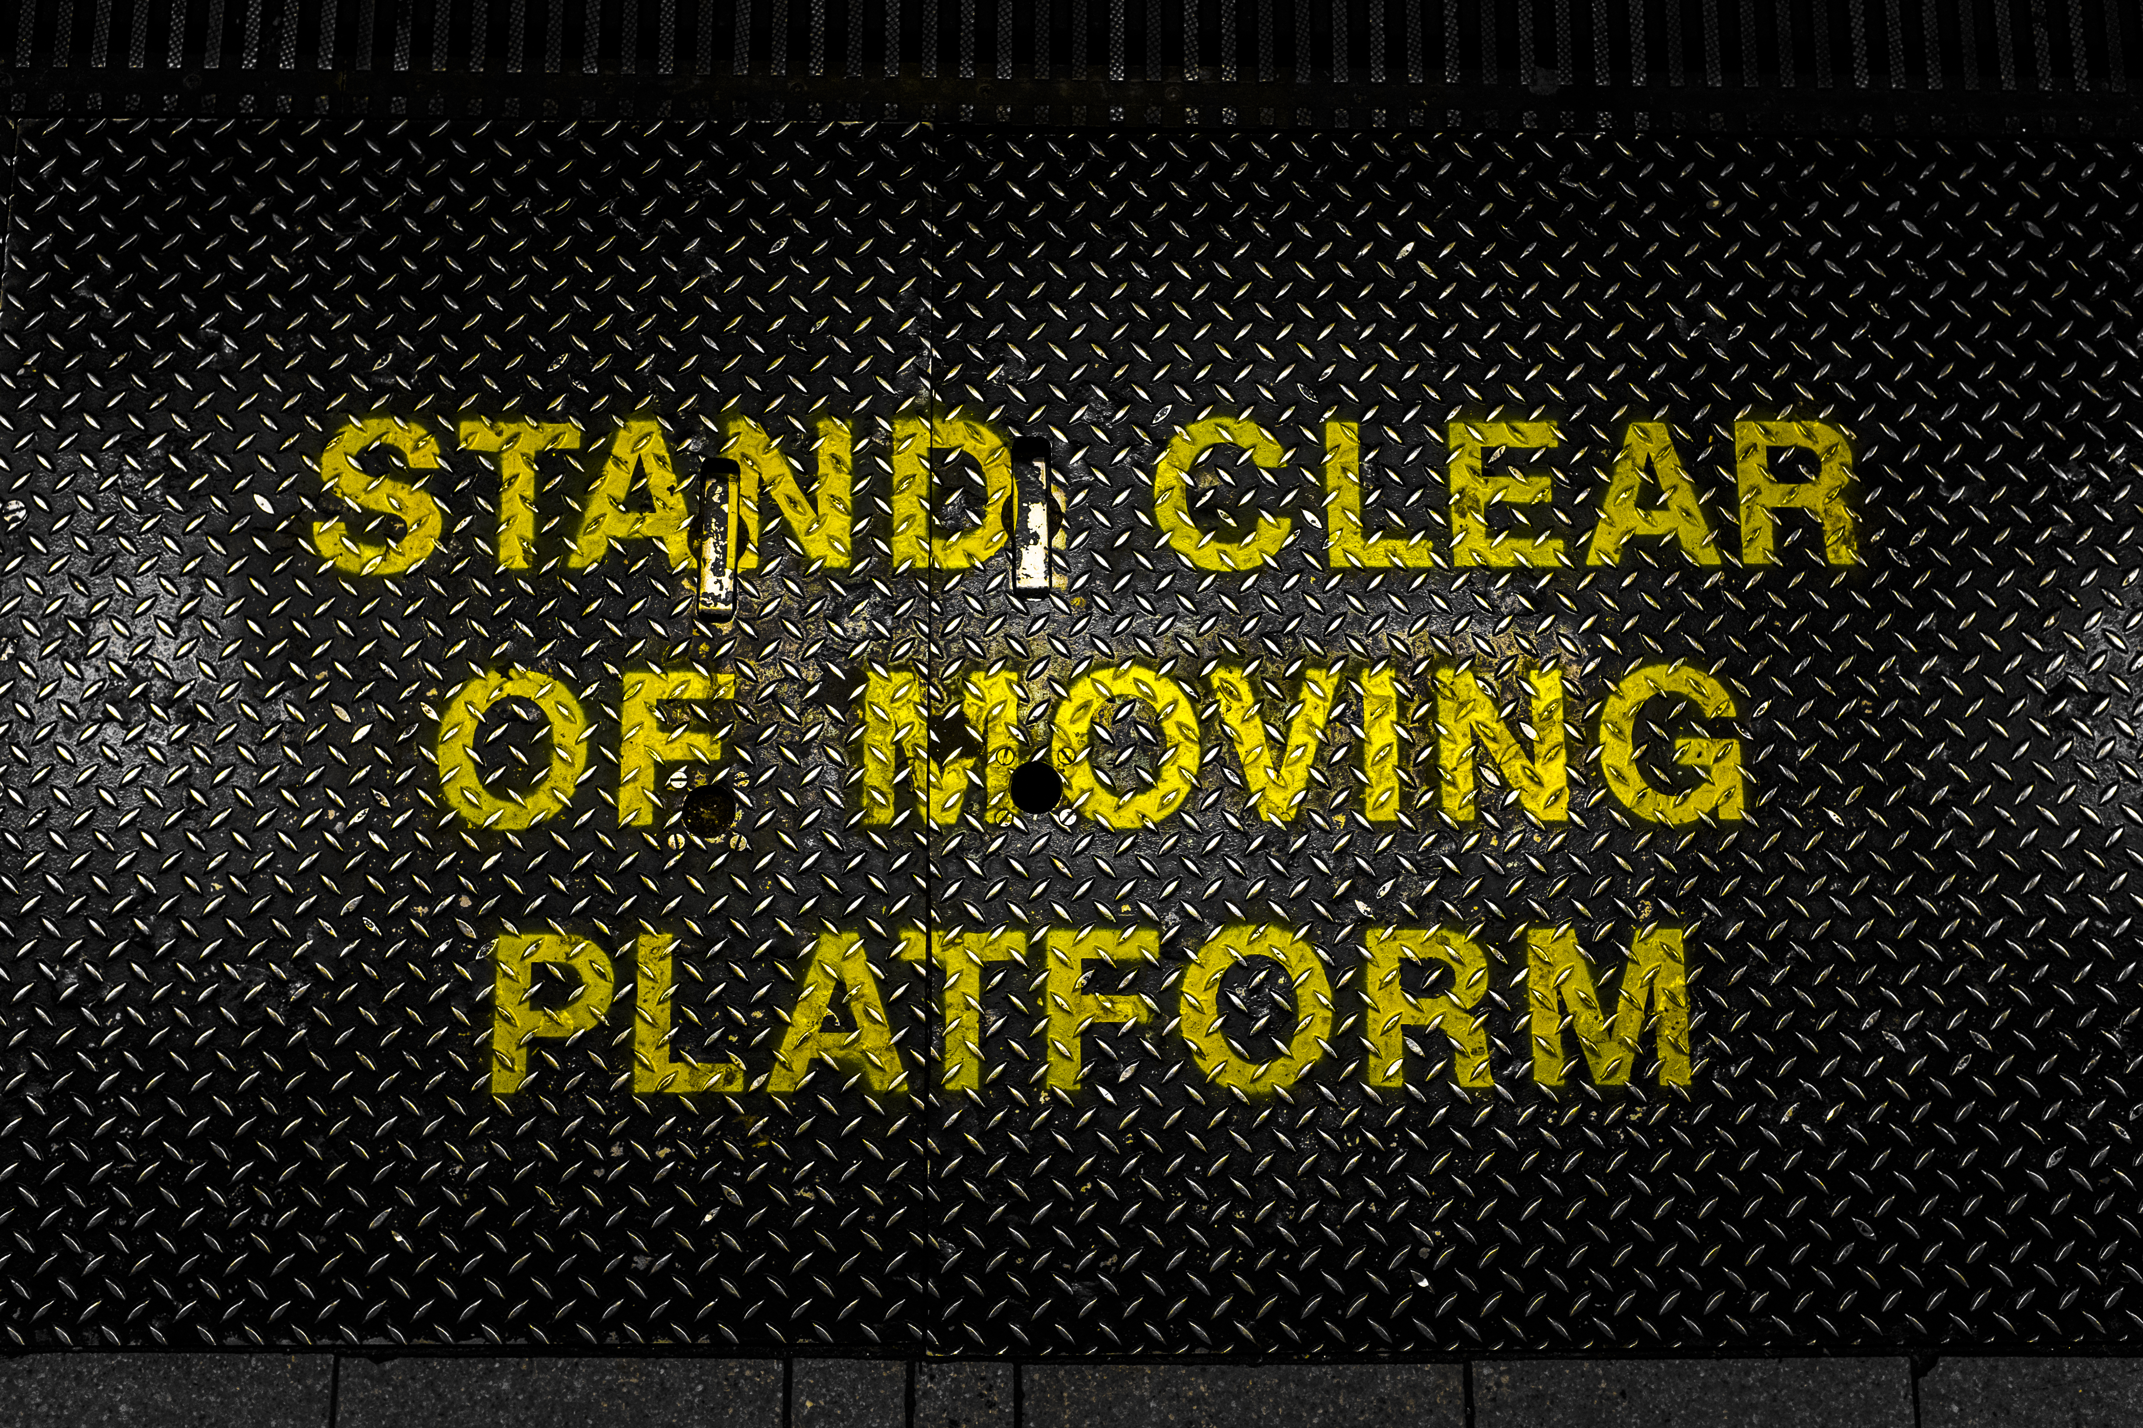
Cost Gap A gap between how you charge for your service and how you are charged for consumption of cloud resources.
Notes:
Today we are going to focus on this one :
Price :- was a fixed price (1/32) of their licence fee, but didn’t incorporate service operating costs, only a support charge.
Cost of Service is largely fixed in an IaaS environment as you are usually running VM’s.

Slide 31
Looking forward .. Utopia … You “SaaSify”* the app You deploy it to PaaS / Serverless You change your billing model You are now ISV Leaders in SaaS But….
* Not a real word

Slide 32

What often happens … Where ISVs do not have a cloud or SaaS ready product, they deploy what they have and try to make it fit….. Extend ISV time to profit by x months. Add new risk of customer termination Add new risk of over-consumption (risk of under-pricing against fixed IaaS resource costs) – results in excessive cost or under-performance. Add new risk of under-consumption of resource (IaaS over-provisioning)
Notes:
So what really happened here ?
https://commons.wikimedia.org/wiki/File:Dangerous_Cliff_Edge_(2258425643).jpg
This file is licensed under the Creative Commons Attribution-Share Alike 2.0 Generic license.

Slide 33
Transitioning to SaaS - challenges Extend ISV time to profit by x months. Add new risk of customer termination Add new risk of over-consumption (risk of under-pricing against fixed IaaS resource costs) – results in excessive cost or under-performance. Add new risk of under-consumption of resource (IaaS over-provisioning)
Notes:
So what really happened here ?
The two top items are pricing and commercial concerns, from a tech perspective there isn’t much we can do about them.
The bottom two are inside our control, it doesn’t have to be this way !
https://commons.wikimedia.org/wiki/File:Dangerous_Cliff_Edge_(2258425643).jpg
This file is licensed under the Creative Commons Attribution-Share Alike 2.0 Generic license.

Slide 34
So, how do you cost your software?
Perhaps we should take some inspiration from an industry we are all familiar with ….

Slide 35

Restaurants understand food cost, portion control and correct menu pricing
How much you pay for food determines how much you need to charge for it
Food cost should be around 30-35 percent of charged price
Take a Filet Mignon dinner:
Beef filet costs you £6 per portion
Wrap (potato, vegetable, salad & bread) costs £2.50
Menu price = cost of your product/.35 i.e. £8.50/.35= £24.29
So, £24.29 is the absolute minimum you need to charge in order to make a profit off the dinner

Slide 36
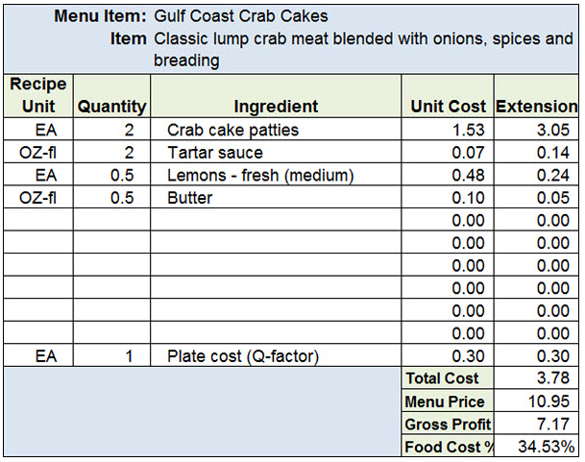
Menu Cost Form
The catering industry is awash with Excel templates, on-line calculators, etc

Slide 37
(TCO / TAPL) = CPT
…You need to be able to break down your system into “ingredients” (units of work or load on the system) and work out that cost:
TCO = Total Cost of Ownership (of a Deployment Unit), including Service Hosting Cost + Operations and Support Staff
TAPL = Transactions at Peak Load
CPT = Cost per Transaction
Notes:
How are users using my service, what are they doing, how long does it take to run certain transactions.

Slide 38
CPT / (1 - Margin uplift needed) = Sale Price per Transaction
…then work out how much you need to sell that transaction cost for:
TCO = Total Cost of Ownership (of a Deployment Unit)
TAPL = Transactions at Peak Load
CPT = Cost per Transaction
Notes:
How are users using my service, what are they doing, how long does it take to run certain transactions.

Slide 39
Now your pricing can be calculated via selling transactions in a “serverless” pricing model (with a direct link from your delivered customer value to the paid price) Or by selling a fixed capacity by selling multiples of Deployment Units to support x users.
Notes:
How are users using my service, what are they doing, how long does it take to run certain transactions.

Slide 40
Serverless What about these Azure Functions?
Notes:
Let’s look at some patterns and practices that can be used to mitigate the cost of building high-performance solutions.
How can you ensure maximum performance and scalability for a commercially reasonable Cost of Service?

Slide 41
Key aspects of ‘Serverless’ technologies.
Technical: Deploy code that just runs, no servers (or containers) to patch, manage or maintain.
Business: Operate services that just run, no servers to pay for or monitor – just pay for the resources consumed via the operation of the service itself.

Slide 42
Why would a Developer want to use serverless ?
Ultimate DevOps
Deploy your code package to a single location, deploy it once and see it scale out massively.
Ultimate Encapsulation and Testability
The logical end game when building applications on serverless is highly isolated nano (or) pico-services collected together into a logical API, whether that is RESTful or RPC/https or Service Bus/Queue based.
Ultimate Simplicity
Nothing to manage, the server architecture is all provided for you and scaled and managed on your behalf. You focus on the code and bindings and only the code and bindings.

Slide 43
Why would an IT Pro want to use serverless ?
Predictable and variable cost
My budget will stretch further and I can chargeback based on usage.
Hugely simplified management and ops landscape
No network / patch management on the servers, as there are no servers.
It’s awesome for running operations and management + monitoring services too.
Now we can run monitoring and clean-up batch scripts and console apps without need ing a permanently available server to run them on, what’s not to like?

Slide 44
Serverless = You are not being charged for the runtime cost of a server directly. #1
The risk of under consumption (and hence wastage) of provisioned service transfers to the provider (Microsoft)
and away from the customer.
Don’t consume: Zero charge – The origin and barrier
to entry £Zero – or better than zero on ‘Consumption priced’ services that have a free tier.
Consume: Predictable charge so you can calculate a margin.

Slide 45
Serverless = You are not being charged for the runtime cost of a server directly. #2
The risk of over consumption (and hence poor performance) of provisioned service transfers to the provider (Microsoft)
and away from the customer.
Over consume: Pass the additional consumed cost on to your end-consumer of the service as a usage charge.

Slide 46
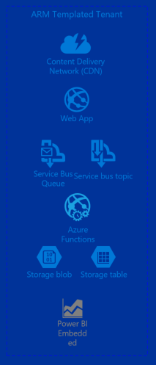

Some Services in Azure that can run on solely Consumption based pricing
Azure Functions
Azure Storage
Azure CDN
Azure Service Bus
Azure Event Hubs
Power BI Embedded
+ Many, many more
Notes:
It is possible to build sites and apps that run only on these services, to leverage consumption based pricing and build high-performance sites and apps that scale linearly and predictably, with costs that scale linearly and predictably.

Slide 47
Serverless: What’s the benefit for me?
Predictable, per-transaction billing
Mass scale out with no incremental cost of provisioning
Cost origin that starts at zero
Free service whilst consumption is reduced or minimal
Notes:
Billed by runtime of transactions, pay truly upon usage, not ‘near to’ estimated / provisioned usage.
Forget about how many servers you need, only care about how many you transactions that want to charge for.
Want to bootstrap a service quickly, with minimal investment – serverless based plans are disposable.
Only pay for what you actually consume, let Microsoft take the risk and revenue hit of provisioning and reserving a massive pool of server hardware.

Slide 48
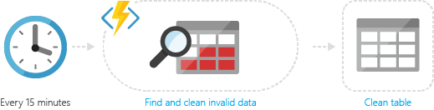
Common Scenarios for Functions
Timer-based processing
Azure Functions supports an event based on a timer using CRON job syntax. For example, you could execute code that runs every 15 minutes and cleans up a database table based on custom business logic.

Slide 49
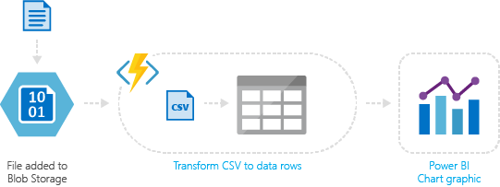
Common Scenarios for Functions
Azure service event processing
Azure Functions supports triggering an event based on an activity in an Azure service. For example, you could execute serverless code that reads newly discovered test log files in an Azure Blob Storage container and transforms this into a row in an Azure SQL Database table.

Slide 50
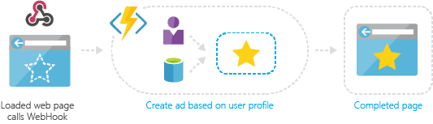
Common Scenarios for Functions
Serverless web application architectures
Azure Functions can power a single page app. The app calls functions using the WebHook URL, saving user data and deciding what data to display. Or, you can do simple customisations, such as changing ad targeting by calling a function and passing it user profile information.

Slide 51
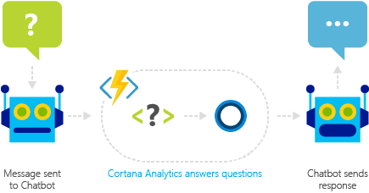
Common Scenarios for Functions
Real-time bot messaging
Azure Functions can be used to customise the behaviour of a bot using a WebHook. For example, you can create an Azure Function that processes a message using Cortana Analytics and call this function using Bot Framework.

Slide 52
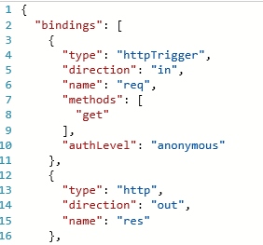
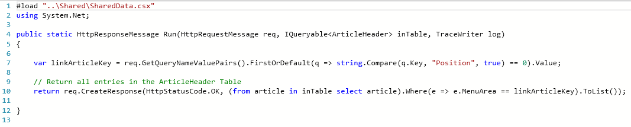
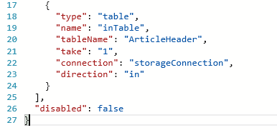
Functions programming concepts (C#)
Trigger
Input(s)
Output
Code

Slide 53
Azure Functions
Notes:
Chris R: - Setup and demonstrate the cloud-load-test feature in VSTS to baseline the following URLs
Stage 1 testing
Main Site
Only via north site at first … (devdemnwebapp.azurewebsites.net)
Only via north site at first … (devdemnfnapp.azurewebsites.net)
Stage 2 Testing – CQRS comes later
GET http://whattodoandavoidwebsite.azurewebsites.net -- Root
GET http://whattodoandavoidfnsite.azurewebsites.net/api/ArticleList -- List
GET http://whattodoandavoidfnsite.azurewebsites.net/api/ArticleGet -- Read
POST http://whattodoandavoidfnsite.azurewebsites.net/api/ArticleUpsert -- Upsert

Slide 54
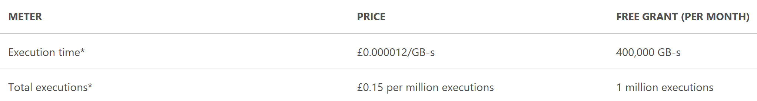
Functions - Dynamic tier pricing
Consumption plan billed on resource consumption + executions
Execution time
Metered in Gigabyte Seconds(GB-s)
Duration of execution (rounded nearest 100 ms) x reserved memory (128 MB increments between 128 MB and 1,536 MB)
Free grant of 400,000 GB-s execution time per month
Number of executions
The first million executions included free each month
https://azure.microsoft.com/en-gb/pricing/details/functions/

Slide 55
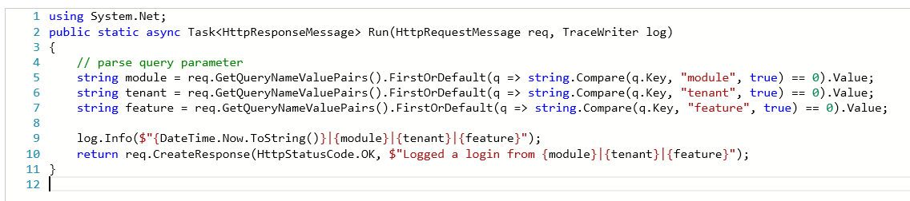
My Function code C#
\BillingTelemetry\Run.csx

Slide 56
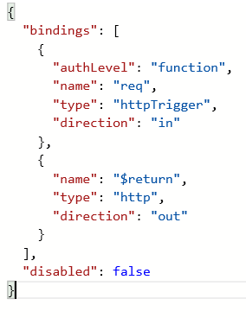
My Function code - PowerShell
\BillingTelemetry\run.ps1
\BillingTelemetry\function.json

Slide 57
Do: Consider licences of additional software
Cloud or on-premise licences with Cloud-usage rights.
Verify the use of each license is appropriate - for example SQL Server in Azure pricing vs. bring your own SQL Server from EA - typically EA pricing discounts would mean cheaper SQL Server for a 24x7 running SQL VM than Azure pricing.
Check Runtime Licencing that is per-core or per-server.
Per-core licencing is more flexible in auto-scale environments than per-server licences.
As you can licence a smaller number of cores for a reduced cost, culminating in an auto-scale cost of 1 core when the service is idle.

Slide 58
Azure Billing Understand your bill for Microsoft Azure
Notes:
Let’s look at some patterns and practices that can be used to mitigate the cost of building high-performance solutions.
How can you ensure maximum performance and scalability for a commercially reasonable Cost of Service?

Slide 59
Azure Portal
Lots of variances, due to Free Trials, MSDN, Enterprise Agreements, CSPs, Pay-as-you-go, BizSpark,….
Start with the Azure portal
Restricted to members of Billing Reader role
You can set up email notifications
You can specify billing alerts

Slide 60
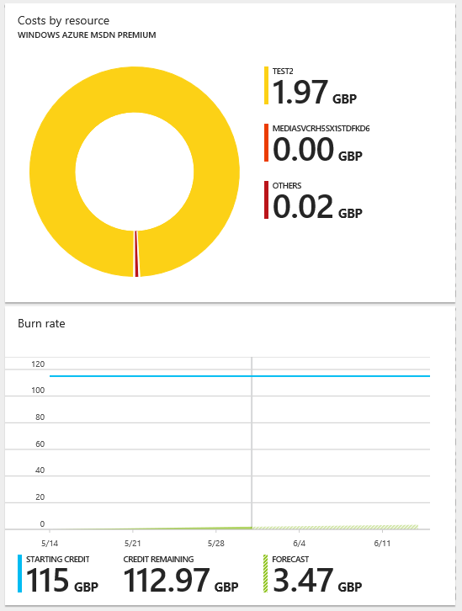
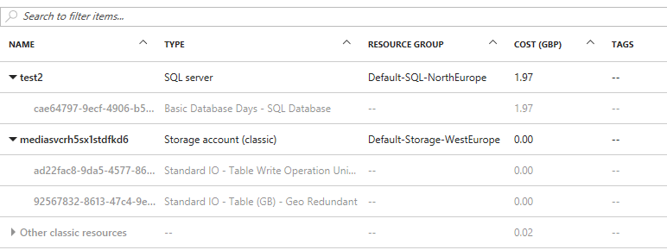
portal.azure.com
Cost Analysis
Overview
Notes:
https://www.petri.com/understand-your-microsoft-azure-spending

Slide 61
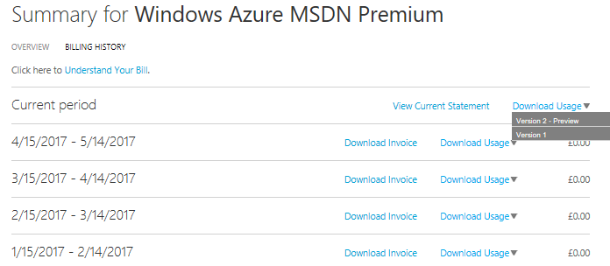
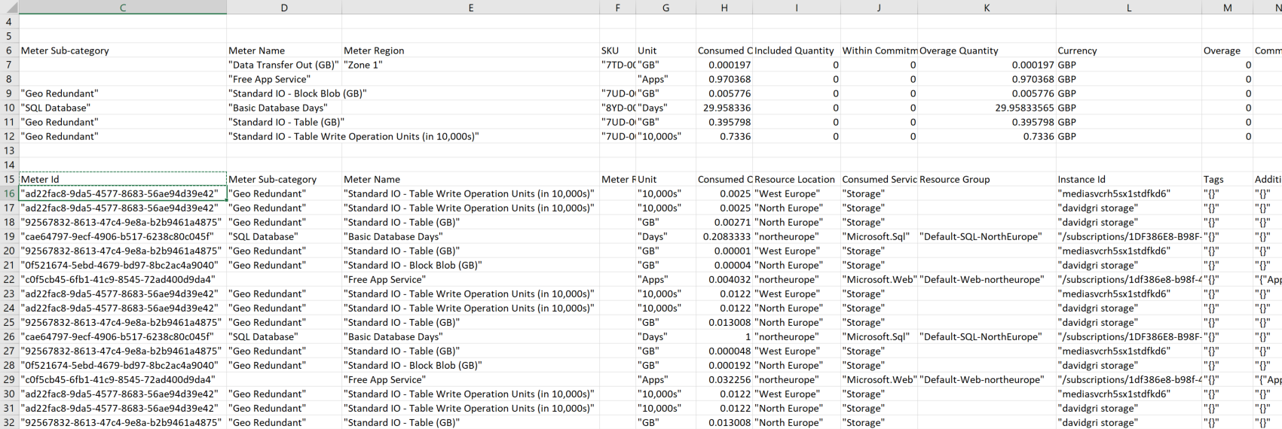
account.azure.com

Slide 62
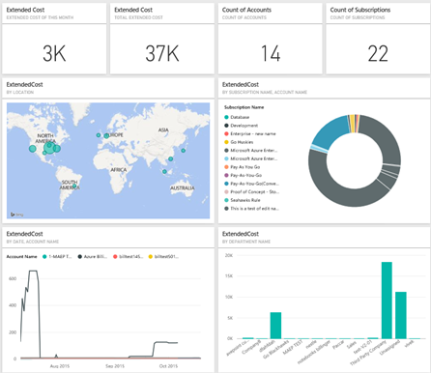
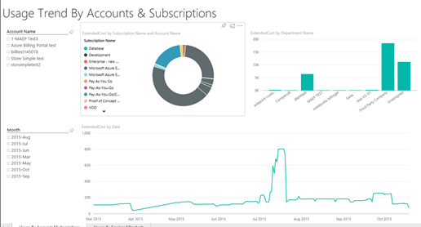
Azure Enterprise content pack for Power BI
Import consumption data into Power BI for Azure Enterprise Agreements
Gain insights into which departments, accounts, or subscriptions are consuming the most
Provides visibility into which services organization used most and trends for spending
Notes:
https://blog.appliedis.com/2016/02/12/analyzing-azure-billing-and-usage-data-with-power-bi/

Slide 63
Azure Billing APIs (Preview)
Use Azure Billing APIs to pull usage & resource data into your preferred data analysis tools and systems
Cloudyn and CloudCruiser work support these APIs
APIs
Billing - programmatic access to Azure billing information & invoices
Resource Usage - get consumption data for an Azure subscription
Resource RateCard - meter (aka resource) metadata information prices

Slide 64
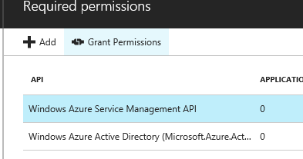
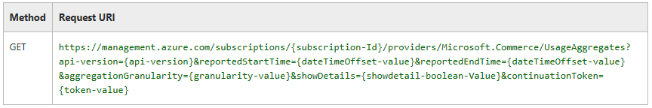
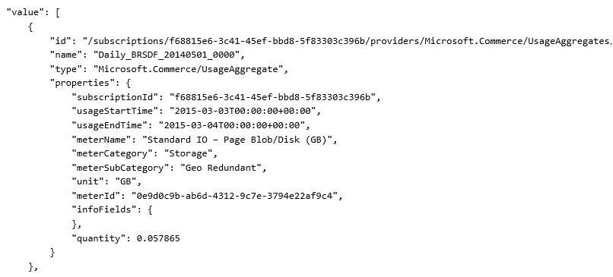
Resource Usage API Demo
https://azure.microsoft.com/en-gb/resources/samples/billing-dotnet-usage-api/
Note: I needed to do a grant access

Slide 65

Evaluation Forms
We hope you have enjoyed the morning, we have one ask of you.
Please out your evaluation forms to give us feedback on what we did right and how we can improve the sessions next time.
Your feedback is critical to making more of these sessions a success !

Slide 66
Links and Downloads
Free Cloud Design Patterns ebook
http://www.microsoft.com/en-us/download/details.aspx?id=42026
Cloud Design Patterns Poster
https://azure.microsoft.com/en-us/documentation/infographics/cloud-design-patterns/
This session - Demos and Presentation Repository
https://github.com/dxuk/AzureWorkshops/blob/master/BestPractices-1stSept2016/Best%20Practices%20-%20Scalability%2C%20Availability%2C%20Performance%20and%20Resilience.pptx

